Slide 1
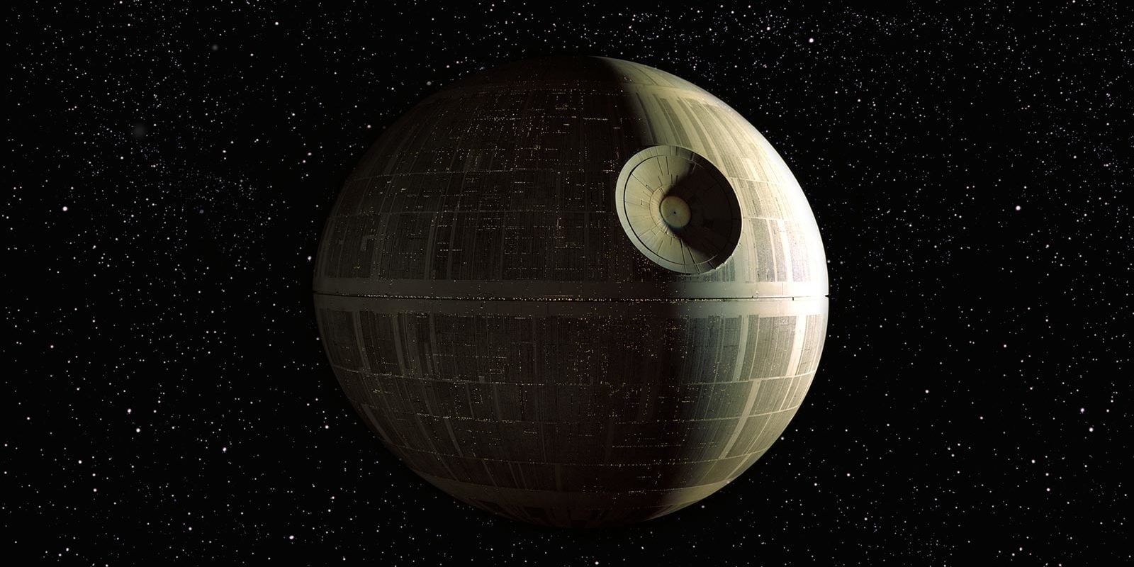
For The Glory of the Empire

